Slide 1
UNIT FIVE
BASICS OF PROGRAMMING IN C++
PART ONE

Slide 2
2.2 Structure of C++ Program
The following example illustrates the generalized form of a C++ program in Dev C++ Compiler .
A line-by-line explanation describing the meaning of each line in the program follows the example .
The example may appear over simplified , but it implies many thing about the C++ language and the way C++ source programs are entered in to the computer .

Slide 3
# include <iostream >--------------------Line 1
using namespace std;---------------------Line 2
main ( ) -----------------------------------Line 3
{---------------------------------------------Line 4
int a , b;-------------------------------------Line 5
-------- ----------------Line 6
---- ----------------Line 7
b=15 ; --------------------------------------Line 8
}---------------------------------------------Line 9
The above Structure of C++Program consists of three main parts:
1 .The include directive
2. using namespace std;
3 . main function .
4 Declaration of Variables

Slide 4
1. The Include directive
#include <iostream>
It is a preprocessor directive, which is a message to the C++ preprocessor.
Lines that begin with # are processed by the preprocessor before the program is compiled.
This line notifies the preprocessor to include in the program the contents of the input/output stream header file <iostream>.
This file must be included for any program that:
Outputs data to the screen or
Inputs data from the keyboard
2. using namespace std;
Namespaces in C++ are used to define a scope and allows us to group global classes.

Slide 5
In old compilers such as Turbo C++ 3.0, Turbo C++ 4.5 and others using namespace std is not supported.
But in recent Compilers such as Dev-C++ and CodeBlock using namespace std is necessary.
This is because it is the only method for compiling and running the program.
When you use namespace std; you are instructing C++ compiler to use the standard C++ library such as cin, cout and etc.
If you don’t give this instruction, then you will use std::, each time you use a standard C++ function/ entity.

Slide 6
3. Main function
This line tells the compiler main() function i.e.; is the entry point of any C++ program as the control always go to main() on startup.
Without the main() in your program, an error will be generated.
C++ program consists of one or more functions.
One function with in a program is called “main” and this is where the program begin execution.
The brace next to main( ) ( { ) tells the compiler the beginning of the main function.
The open brace that indicates to C++ the beginning of the main functions in the program.

Slide 7
4. Declaration of Variables (Object)
To start with an object is any thing like constants, variables, functions and structure
Line 5 is an example of the declaration of a variable in C++.
The variable declared is an integer named “a” and “b”.
Line 6, 7 and 8 represents the body of C++ statements that accomplishes the purpose of the main function.
Line 9 is the close brace (}) that indicates to the C++ compiler to end the main function.
Everything between the braces is part of the main function.

Slide 8
Example 1
//Program To Calculate sum of two numbers
#include <iostream>
using namespace std;
int main(){
int num1;
int num2;
int sum;
cout << "Enter first Number: ";
cin >> num1;
cout << "Enter second Number: ";
cin >> num2;
sum = num1 + num2;
cout << "Sum is " << sum << endl;
return 0;
}

Slide 9
2.2.1 Typical C++ Development Environment
C++ systems generally consist of three parts:
Integrated Development Environment (IDE)-is an application or set of tools that allows a programmer to write, compile, edit, and in some cases test and debug within an integrated, interactive environment.
Language
C++ Standard Library
C++ programs typically go through six phases:
Edit
Preprocess
Compile
Link
Load
Execute

Slide 10
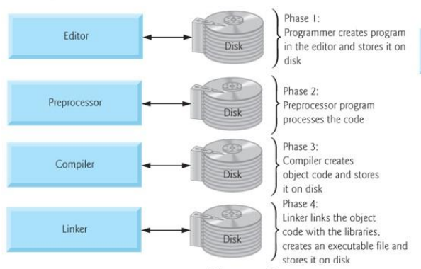
2.2.1.1 Six-phases of C++ Programming

Slide 11
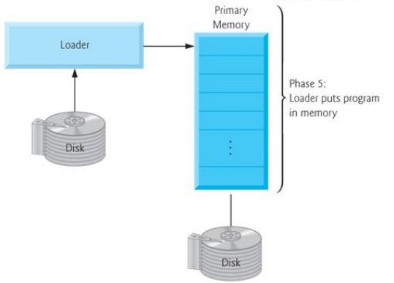
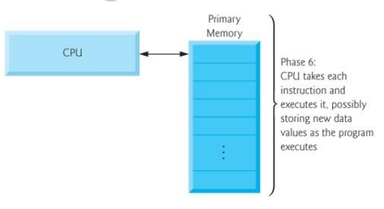

Slide 12
Phase 1- Editing
Use a text editor to create C++ program following the rules, or syntax, of the high-level language.
This program is called the source code or source program.
The program must be saved in a text file that has the extension .cpp.
Source program: A program written in a high-level language.
Examples of Editors:
Linux – vi, emacs,
Microsoft Windows – Microsoft Visual C++, Dev-C++, CodeBlock and Simple editors like Notepad, Programmers NotePad and etc.

Slide 13
Phase 2 – Preprocessing
The C++ preprocessor obeys commands called preprocessor directives, which indicate that certain manipulations are to be performed on the program before compilation.
The preprocessor to include in the program the contents of the input/output stream header file <iostream>.
This file must be included for any program that outputs data to the screen or inputs data from the keyboard
The C++ program usually contains the statement #include .
In a C++ program, statements that begin with the symbol # are called preprocessor directives.
These statements are processed by a program called preprocessor.

Slide 14
Phase 3 – Compiling
To verify that the program obeys the rules of the programming language—that is, the program is syntactically correct—and translate the program into the equivalent machine language.
The compiler checks the source program for syntax errors and, if no error is found, translates the program into the equivalent machine language or machine code.
The equivalent machine language program is called an object program or object code .
Object program: The machine language version of the high-level language program.

Slide 15
Phase 4 – Linking
The programs that you write in a high-level language are developed using a software development kit (SDK).
The SDK contains many programs that are useful in creating your program.
For example,
It contains the necessary code (program) to display the results of the program and
Several mathematical functions to make the programmer’s job somewhat easier.
Therefore, if certain code is already available, you can use this code rather than writing your own code.
Once the program is developed and successfully compiled, you must still bring the code for the resources used from the SDK into your program to produce a final program that the computer can execute.

Slide 16
This prewritten code (program) resides in a place called the library.
Linker: A program that combines the object program with other programs in the library, and is used in the program to create the executable code
Phase 5 – Loading
Before a program can be executed, it must first be placed in memory.
Loader: A program that loads an executable program into main memory.
The loader takes the executable image from disk and transfers it to memory.
Additional components from shared libraries that support the program are also loaded.

Slide 17
Phase 6 - Execution
Finally, the computer, under the control of its CPU, executes the program one instruction at a time.
Some modern computer architectures can execute several instructions in parallel.
Problems that may occur at execution
If problem occurs, you have to return the editor phase, make necessary corrections and proceed with rest of the phases.

Slide 18
2.3 Character sets, whitespace characters, keywords
2.3. 1. Character Sets
The character sets of C++ is consists of letters, numbers, punctuation marks, special characters and blank (white space) characters.
The letters and numbers are used to form constants, variables, identifiers and keywords.
The punctuation marks and special characters have explicit meaning in C++
The following are the letters and numbers in C++ character set (62).
A B C D E F G H I J K L M N O P Q R S T U V W X Y Z
a b c d e f g h I j k l m n o p q r s t u v w x y z
0 1 2 3 4 5 6 7 8 9

Slide 19
The following are the punctuation and special character in C++ character set (29)
Characters | Description | Characters | Description
, | Comma | . | Period
; | Semi colon | : | Colon
? | Question mark | ! | Exclamation mark
“ | Double Quote mark | ‘ | Single quote mark
( | Left Parenthesis | ) | Right parenthesis
[ | Left Bracket | ] | Right bracket
{ | Left Brace | } | Right brace
< | Left angle bracket | > | Right angle bracket
/ | Forward slash | \ | Backslash
| | Vertical bar | ~ | Tilde
+ | Plus sign | - | Minus sign
# | Pound sign | % | Percent sign
_ | Under score | ^ | Caret
& | Ampersand | * | Asterisk
= | Equal sign | <> | Less than or greater than symbols

Slide 20
2.3. 2 Whitespace Characters
Any character that produces blank space when printed is called a white space character.
The white space characters are spaces, tabs, new-lines and comments.
White space characters separate otherwise adjacent words.
Use them freely to make programs easier to read and understand.
2.3.3 Keywords
Keywords are also known as reserved words that have special meaning to the C++ compiler and are always written or typed in short (lower) case.
Keywords are words that the language uses for a special purpose, such as void, int, public, etc
You can not use a keyword for a variable name or a function name.

Slide 21
C++ does not know what cin and cout are until sees the compiler directive #include<iostream>.
Once the directive has been used, it would be difficult or impossible to write a program using cin or cout as a variable or function name.
The following identifiers (33 in number) are reserved for use as keywords, and may not be used otherwise.
Examples of Keywords
auto | continue | else | long | union
break | default | enum | register | unsigned
case | do | extern | return | void
char | noalias | float | short | volatile
const | double | for | signed | while
goto | if | int | sizeof | class
static | struct | switch | typedef | this
inline | new | delete | public | overload

Slide 22
2. Identifiers
The term identifier is used to describe the name of variables, constants and functions.
All are assigned names to identify the variable, constant or function.
The names of identifiers must follow the naming requirements.
An identifier is a sequence of letters and digits.
The first character must be a letter; the underscore _counts as a letter.
Upper and lower case letters are different.
Identifiers may have any length, and for internal identifiers, at least the first 31 characters are significant, some implementations may make more characters significant.

Slide 23
2.4.1 Rules of Writing Identifiers
Identifiers must start with a letter (uppercase or lowercase, A-Z, a-z) or an underscore.
It should contain only letters, digits and underscore symbols.
Maximum length of characters for identifiers is 32 characters but it is not fixed as 32, it may be different from compiler to compiler.
Keywords or reserved words cannot be used as an identifiers.
The following are examples of valid identifiers:
x, pay, sales_cost, TOTAL, MAY,
Z54321, k9, ThisisChristmassday, Gross_pay

Slide 24
The following are some examples of invalid identifiers:
RUN; //includes a punctuation characters
?1stterm //Start with punctuation characters
_ //Underscore alone
Net-pay //Includes a punctuation characters
Net Pay //includes a space
switch //It is C++ keywords
\n //Starts with punctuation character

Slide 25
Exercise
State whether each name in this exercise is valid identifier or invalid identifier. If the name of identifier is invalid, explain why it is?
sum_of_credits _type_of_car
while SECTION_6
bingo-square 3_4_87
initial tree final_#
sum 2nd_total
secondsum long
TOTAL-PAY column 1
total_pay abcde3456
if switch
num1 number_two?

Slide 26
2.4.2 . Variables
Variable is a place holder to store data such as numbers, characters, or even complete records in a memory to enable their processing by a program.
Variables are also referred to as objects, particularly if they belong to a class.
The variable is referred to by the name that is assigned to it.
A variable must be defined before you can use it in a program.
When you define a variable, the type is specified and an appropriate amount of memory is reserved.
This memory space is addressed by reference to the name of the variable.

Slide 27
2.4.3 . Functions
Functions are independent routines that can be called from a different or the same routine to perform an operation and then return a value to the calling routine.
A function is referred by the name that is assigned to it.
2.4.5 . Constants
A constant is a data object whose value does not change during program execution.
A constant that is assigned a name is considered an identifier and follows the naming requirements.
These are also known as Literals. A literal is a piece of data that will never change.
For example the line x= 2 * y; has a 2 that is a literal.
It will always multiply by 2, no matter what does the program is using

Slide 28
2.5 Syntax and Comments
Syntax means a set of rules to define the proper content and construction of the C++ statements, similar to the grammar rules of a natural human language.
For example the syntax to define a variable is
data_type Var_Name1, Var-Name2 ------Var_NameN;
Comments in C++ can be described by two slashes(//) at the beginning and which lasts until the end of line.
No closing brackets are required. With this method if you want to include your comments in one line you have to type // at the beginning of each line.
You can use both comment styles in C++. For example to comment out large blocks of code:
/* C++ comment can include // and can open over several lines */
When the program started to execute the compiler ignore it.

Slide 29
2.6 C++ Statements
The C++ statement is an expression that is terminated with a semicolon.
The semicolon (terminator) must be present to indicate the end of a C++ statement.
Preprocessor directives and functions such as main() do not require a semicolon at the end of a line but all C++ statement always end with a semicolon.
For example, the following are valid C++ statements end with a semicolon.
int number1, number2;
sum= number1 + number2;
cout<<“Sum =“<<sum;
return 0;

Slide 30
Exercise
Identify either the following C++ statement is valid or invalid
long x;
sum=x+y,
cout<<“average”;
cin>>x>>y;
cout<<“Sum=“<<sum;
int x; y; z; sum,
main();
cout<<“x=“<<x<<endl,
float x,y;
#include<iostream>;
using namespace std;

Slide 31
2.7 Standard Input and Output streams
C++ has its own set of I/O library syntax which is easy to use.
This is defined in a header file called <iostream.h> or <iostream>, which we must include in our program before ‘main’ function.
The following is the syntax for including a library file in C++ program is:
The ‘hash’ sign (#);
Followed by the word “include”,
And then followed by the name of the appropriate header file in pointed brackets(<>).
#include<headername>

Slide 32
A) cout:The Standard Output Stream
The cout variable or object is the C++ standard output stream which writes to the consol.
For example, the following is a valid cout statement:
cout<<“Hello Programmer”;
This statement sends the “Hello Programmer” string to the standard output device stream, represented by the cout object.
The <<operator (bitwise shift left operator “<<“)or insertion operator, is the output operator.
Suppose you want some value to be input to program, the output could be:
cout<<“Enter the first Number……”;
This will cause the following message to be printed on the console:
Enter the first Number……

Slide 33
Note
The message printed is exactly in the manner you entered it in to computer.
If you make any spelling error, computer will repeat it.
2. Entire prompting message has to be enclosed inside the pair of double quotes “ “.
3. The prompting message is given in the form of the string which can contain all valid characters except the double quote symbol”.
The gap between two words is repeated in the same manner as is typed by the user during making program.
4. Use the symbol <<. This symbol means that the object (i.e.; the string following this symbol) is to be directed out to standard output device console
5. The cout variable statement must be followed by a semicolon.

Slide 34
B) cin: Standard Input Stream
To input data from the keyboard, we use the word ‘cin’ followed by the extraction(‘get from’) operator, which is a set of two greater than symbols, >>.
If you want to get some value inputted for example by user, you will have to type cin>>amount
This statement has two portions cin and amount.
Here cin is the object (command) asking the computer to accept input as typed by the user through standard input device i.e; keyboard and (when enter is pressed) will put the value in to the variable ‘amount’
amount is a variable which will hold the numeric value say 3000 in memory as entered by user.

Slide 35
This indicates that user has entered a value of 3000 which is stored in memory as the current value of the variable amount.
We can always retrieve this value from computer’s memory by output statement like
cout<<amount, then the console will show the value to be 3000.
The following sample program uses cin to read an integer from the keyboard by prompting the user to enter the value.
Then this value is outputted on console with the message. The amount you entered.

Slide 36
Example
  # include <iostream.h>
  main()
  {
  int amount;
  cout<<“Enter an amount ….”;
  cin>>amount;
  cout<<“The amount you entered was “<<amount;
  }
  This program sends a string to cout to prompt you for input, the cin device writes the value that you enter in to the amount integer variable.
  The program then displays the amount variable on cout to demonstrate that the cin operation worked.
  Enter an amount… 420
  The amount you entered was 420

Slide 37
2.8 Data Types and Variables

Slide 38
2.8.1 Data Types
A data type defines a collection of data values (objects or variables) and a set of predefined operations on those values (objects).
Therefore, the type defines:
1. The internal representation of the data
2. The amount of memory to allocate
Computer programs produce results by manipulating data.
Variables are nothing but reserved memory locations to store values.
This means that when you create a variable you reserve some space in memory.
You may like to store information of various data types like character, wide character, integer, floating point, double floating point, Boolean and etc.

Slide 39
Based on the data type of a variable, the operating system:
Allocates memory spaces and
Decides what can be stored in the reserved memory.
Since a computer uses different methods for processing and saving data, the data type must be known..
A number such as 1000 can be stored in either 2 or 4 bytes.
When accessing the part of memory in which the number is stored, it is important to read the correct number of bytes.

Slide 40
The type of data element is a characteristic restricting it to a particular range of possible values
The basic data types available in C++ are
Integer
Floating Points
Character
Boolean
Integer data type can be further modified as:
    int
    unsigned int
    short
    unsigned short
    unsigned long

Slide 41
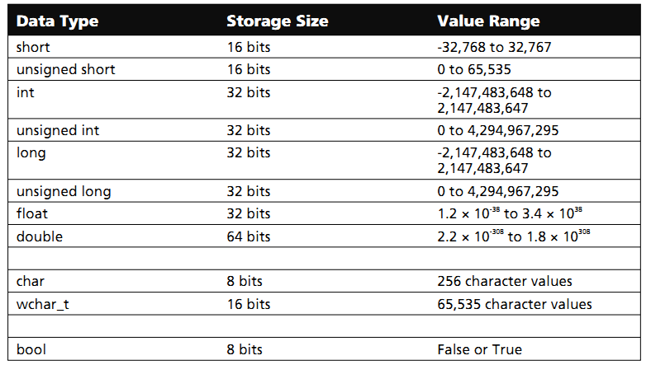
The following table shows the variable type, how much memory it takes to store the value in memory, and what is maximum and minimum value which can be stored in such type of variables.
(2 byte)
(2 byte)
(2 byte)
(4 byte)
(4 byte)
(4 byte)
(4 byte)
(8 byte)
1 Byte
2 byte
1 byte

Slide 42
1. Integer Data Type
1.1 int Type
The int type stores integer number values .
The length for int type is either four bytes on most computers.
Integer data have valued that can be used for counting.
Variables of type int take on positive and negative integer values
1.2 short int
The short data type can hold only whole numbers.
It can’t be used to store a number with a fractional part.
The short int type uses 2 bytes to store values in the memory.
The short int type is used to store integer numbers with a range of -32767 to +32767.

Slide 43
1.3 unsigned short
is the unsigned version of the short data type,
This data type stores only positive values but not store a negative number.
The unsigned short uses 2 bytes to store values in the memory.
The unsigned short is used to store positive integer numbers with a range of 0 to 65,535.
1.4 unsigned int
This int type can have only stores positive integers only and up to 65536
The unsigned int uses 4 bytes to store values in the memory
The unsigned int is used to store positive integer numbers with a range of 0 to 4,294,967,295

Slide 44
1.5 long int type
is used to store an integer value that has a range which is larger than a regular integer within a range of -2,147,483,647(2³¹-1) to+ 2,147,483,647
The long int type uses 4 bytes to store values in the memory
In the original C++ compilers, an int data type was implemented using 16 bits of memory, and its storage range was correspondingly smaller.
However, most modern C++ compilers implement the int using 32 bits of memory—the same as for a long.
1.6 unsigned long
is used to store only positive integer values .
The unsigned int type uses 4 bytes to store values in the memory.
The unsigned long is used to store positive integer numbers with a range of 0 to 4,294,967,295

Slide 45
2. Floating –Point Data Types
The data of float type stores numbers that have a decimal place.
The float type has at lest 6 –digits of precision.
The decimal point can occur anywhere within the 6 digits.
In general, use integers to count things, use floating-point for measurement, fractions and approximations.
If the accuracy obtained using a variable of the type float is insufficient for the purpose at hand, it can be declared instead to be of the type double.
This is very similar to the type float, except that it provides about twice the number of significant digits for the result.
The exact number of significant digits varies from system to system, but usually if a float variable has seven digits, a double variable has 16 to 17.

Slide 46
Numbers of the type float and double are treated identically by the system in terms of calculations
As a matter of fact, all floating point numbers are converted in to double values automatically before they are used in any operation.
Using the type float saves memory, however, because a float variable takes up only half as much space as a double.
To display a double value, the format characters %f (for standard floating point notation) or %e(for scientific or exponential notation) are used just as with type float.
Most of the time, we use the relatively small, and therefore less precise, float data type only for rough approximation, to save space in large calculations, and when accuracy isn’t too important.

Slide 47
Activity
Write C++ program to implement int, unsigned int, short int, unsigned short int, long and unsigned long data types and run each of the program and observe its differences by considering the output that you get by inputting different values.
Use float data type and Write C++ program to calculate temperature in Celsius as the user input temperature in Fahrenheit. To Calculate Temperature in celsius, use the following formula. Temp_Cel=((Temp_Fahr-32)*5/9).
Use double data type and write C++ program to compute Total_Sales, vat, service charge and Total_Cost that a buyer pay for the specific product bought or get services in a hotel. Use the following information to write the program:
Total_Sales= (Unit_Price *qty)
Vat=(Total_Sales * 0.15)
Service_Charge=(Total_Sales *0.02)
Total_Cost=(Total_Sales + Vat + Service_Charge)

Slide 48
3. Char Data Type
Character data are defined in C++ by the char data type.
char data type can be of two types:
character strings
char data type of single character
character strings are simply collections of single characters.
A character string may contain a single character or up to 256 characters.
Character strings are always enclosed by double quotation marks.
Example
char data type ‘a’ refers to a character constant, but “a” refers to a character string.
The char type can hold a one byte binary number, a single alpha numeric or special Character or have each but have its own individual value.
The range for a binary number in char type is -127 to +127.

Slide 49
The out put of this program is
C is great!
C++ Example of char Data types
#include<iostream>
using namespace std;
// program 1 to illustrate use or char data type
main() {
char ltr_1='C',
ltr_2=' ',
ltr_3='i',
ltr_4='s',
ltr_5=' ',
ltr_6='g',
ltr_7='r',
ltr_8='e',
ltr_9='a',
ltr_10='t',
ltr_11='!';
cout<<"\n"<<ltr_1<<ltr_2<<ltr_3<<ltr_4<<ltr_5<<ltr_6<<ltr_7<<ltr_8<<ltr_9<<ltr_10<<ltr_11;
}

Slide 50
In program we have used comma, between all the ten char type data 10 that all constant of char type are declared in one statement only .
Although each one of them are written in different lines but that does not make any difference.
Write C++ Program to display the following output
I Love ETHIOPIA!
Program 2 C++ Example of char data type
# include<iostream> //Program to demonstrate Character variable
using namespace std;
main()
{
char charvar1='A'; // define Char Variable as Character
char charvar2='\t'; // define Char Variable as tab
cout<<charvar1; // display Character
cout<<charvar2; //Display the tab character
charvar1= 'B'; // set Char variable to char Constant
cout<<charvar1; // display Character
}

Slide 51
Exercise
Write C++ program to display the following output using char data type and character strings:
A) C D E F
B) P R O G R A M
2. Use char data type of character string to display the following lines of string in a separate line:
Her Unearth Beauty Blinded me that
I can’t see and appreciate the beauty of others

Slide 52
4. Bool Data Type
Arithmetic expressions evaluate to numeric values; a Boolean expression, sometimes called a predicate, evaluates to true or false.
C++ supports the non-numeric data type bool, which stands for Boolean.
The term Boolean comes from the name of the British mathematician George Boole.
A branch of discrete mathematics called Boolean Algebra is dedicated to the study of the properties and the manipulation of logical expressions.
Compared to the numeric types, the bool type is very simple in that it can represent only two values: true or false.
Look the following C++ program to implement the Boolean data type:

Slide 53
#include<iostream>
using namespace std;
int main () {
//Declaration of Variables
int b,n;
//Assign a value 10 to b
b=10;
//Users input the value of n
cout<<"enter the number n :";
cin>>n;
//Test if the value initialized with the value inputted by the //user is ==, > or <
if(b==n){
//This statement is executed if b==n
cout<<"This is executed."<<endl;
}

Slide 54
else {
cout<<"This is not executed."<<endl;
}
//outcome of a relational operator is a Boolean value
cout<<"b>n is "<<(b>n)<<endl;
cout<<"b<n is "<<(b<n);
return 0;
}
The Boolean values false and true are represented as integer 0 and integer 1 respectively.
More precisely, zero represents the bool value false, and any non-zero integer (positive or negative) means true.
The direct assignment to a bool variable of an integer other than 0 or 1 may result in a warning (Visual C++ reports truncation of ’int’ to ’bool’), but the variable is still interpreted as true.

Slide 55
2.8.2 Size of Integers
On any one computer, each variable type takes up a single, unchanging amount of room.
That is, an integer might be two bytes on one machine, and four on another, but on either computer it is always the same, day in and day out.
A char variable (used to hold characters) is most often one byte long.
A short integer is two bytes on most computers, a long integer is usually four bytes, and an integer (without the keyword short or long) can be two or four bytes.
Example:
The following C++ program should help you to determine the exact size of data types on your computer.

Slide 56
/*Pogram to determine the size of variable types of
each data type on your computer */
#include <iostream>
using namespace std;
int main() {
cout<<"The size of int type is:\t\t"<<sizeof(int)<<" "<<"Bytes"<<endl;
cout<<"The size of unsigned int is:\t"<<sizeof(unsigned int)<<" "<<"Bytes"<<endl;
cout<<"The size of a short int is:\t"<<sizeof(short int)<<" "<<"Bytes"<<endl;
cout<<"The size of unsigned short is:\t"<<sizeof(unsigned short int)<<" "<<"Bytes"<<endl;
cout<<"The size of a long int is:\t"<<sizeof(long)<<" "<<"Bytes"<<endl;
cout<<"The size of unsigned long is:\t"<<sizeof(unsigned long)<<" "<<"Bytes"<<endl;
cout<<"The size of a char is:\t\t"<<sizeof(char)<<" "<<"Bytes"<<endl;
cout<<"The size of a float is:\t\t"<<sizeof(float)<<" "<<"Bytes"<<endl;
cout<<"The size of a double is:\t"<<sizeof(double)<<" "<<"Bytes"<<endl;
cout<<"The size of a bool is:\t\t"<<sizeof(bool)<<" "<<"Bytes"<<endl;
cout<<"The size of wchar_t is:\t\t"<<sizeof(wchar_t)<<" "<<"bytes"<<endl;
return 0;
}

Slide 57
2.8.3 Constants (Literals)
Sometimes an unchanging value is used through out a program.
Such a quantity is called a constant.
For instance, if a program deals with the area and circumference of circles, the constant value pi(=2.14159) would be used frequently.
In financial program, interest rate might be a constant.
If the constant is given a descriptive name:
It improves the readability of a program
prevent errors
Constants always have definite values but they may or may not have named.
Constants of all type can be broadly categorized as:
Literal constant like 2.14159 or
Symbolic constant like pie, interest_rate

Slide 58
1. A constant that is identified only by value is called a literal constant.
You include literal constant in program statements by writing their values.
For example, 137.45 identifies an integer constant with the indicated value (in decimal)
A literal constant may appear anywhere in C++ program and will always be correctly interpreted.
2. A constant that is identified by name is called symbolic constant.
In C++ , the word “ const” is used and is applied to normal variable declarations such as;
const int MAX=100;
The int MAX=100; portion is formatted exactly the same way as a normal declaration
The word const in front of it simply defines that the variable MAX can not be subsequently changed.
Note:- A constant is declared by writing constant before the keyword (e.g.int,long, float) in the declaration.

Slide 59
Example
const int num;……………………………………1)
const int time; ………….........................................(2)
const int num, time; ……………………………..(3)
const int num=9, time =15;………………………(4)
const float dist =7.0;…………………………….(5)
float distance =0.0, velocity;…………………….(6)
First two lines contain examples of constant declaration of int type but without assigning their values.
These constants are num and time
We could include them in one statement as shown in third line.
In fourth line attempt has been made to declare the data type with its value assigned therein
Line 5 and 6 are example of float type declaration for constant dist and distance and the value of velocity not initialized.

Slide 60
Example
//C++ program to demonstrate literal and symbolic constants
#include<iostream>
using namespace std;
main (){
//Declaration of symbolic const variables
const int MAX=100;
//Display the MAX value
cout<<"MAX="<<MAX<<endl;
//Declaration of variables local to main
int z, y;
z=(MAX)*2;
cout<<"Z="<<z<<endl;
y=(MAX)*3+10;
cout<<"Y="<<y<<endl;

Slide 61
//Declaration of literal const variable
float r, area;
//Users input the value of radius
cout<<"Enter radius of a circle:";
cin>>r;
//Calculate area with literal value of 3.14156
area=(r*r*3.14156);
//Display output
cout<<"Area="<<area<<endl;
}

Slide 62
2.10 OPERATORS AND EXPRESSIONS

Slide 63
2.10.1 Operators
Operator is the term used to describe the action to be taken between two data operands.
An identifier (or a constant or a variable) used with an operator is called an operands.
For example, the arithmetic multiply operator is used to multiply two identifiers together, and the assignment operator is used to set an identifier equal to a value.
Expressions are made by combining operators between operands.
Expressions are evaluated by applying the operator to the operands involved.
An expression consists of an operator and an identifier or a sequence of identifiers.

Slide 64
When several operators are in one expression, some of the operators are acted on before others.
Some parts of the expression are also acted on before other parts.
The general form of use of the operators:
operand1 operator operand2
The value of operand2 is applied to operand1 as directed by the operator.
For example, the multiply operator is used to multiply two variables (operands) and the assignment operator (=) assigns the value of one operand to another operand.

Slide 65
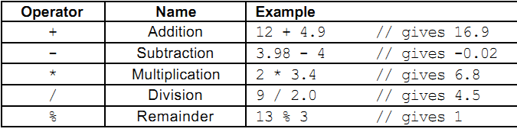
1. Arithmetic Operators
C++ provides five basic arithmetic operators. These are summarized in the following table
Except for remainder ( %), all other arithmetic operators can accept a mix of integer and real operands.
Generally, if both operands are integers then the result will be an integer.
However, if one or both of the operands are float then the result will be a real (or double to be exact).

Slide 66
When both operands of the division operator (/) are integers then the division is performed as an integer division and not the normal division we are used to.
Integer division always results in an integer outcome (i.e., the result is always rounded down). For example:
    9 / 2 // gives 4, not 4.5!
    -9 / 2 // gives -5, not -4!
Unintended integer divisions are a common source of programming errors. To obtain a real division when both operands are integers, you should cast one of the operands to be real:
  int cost = 100;
  int volume = 80;
  double unitPrice = cost / (double) volume; // gives 1.25

Slide 67
The remainder operator (%) expects integers for both of its operands. It returns the remainder of integer-dividing the operands.
For example 13%3 is calculated by integer dividing 13 by 3 to give an outcome of 4 and a remainder of 1; the result is therefore 1.
It is possible for the outcome of an arithmetic operation to be too large for storing in a designated variable.
This situation is called an overflow. The outcome of an overflow is machine-dependent and therefore undefined.
For example: unsigned char k = 10 * 92; // overflow: 920 > 255
It is illegal to divide a number by zero. This results in a run-time division-by-zero failure which typically causes the program to terminate.

Slide 68
Example
//This example illustrates how the arithmetic operators work.
#include<iostream>
using namespace std;
int main() {
//Declaration of int variable with some initial value
int m=54;
int n=20;
//Display the value of m and n
cout << "m="<<m<<" "<<"and n="<<n<< endl;
//Output the value of each operator
cout << "m+n="<<(m+n)<< endl;
cout << "m-n="<<(m-n)<< endl;
cout << "m*n="<<(m*n)<< endl;
cout << "m/n="<<(m/n)<< endl;
cout << "m%n="<<(m%n)<< endl;

Slide 69
cout<<"******************"<<endl;
/*To obtain a real division when both operands are integers,
you should cast one of the operands to be real */
//Declaration of int variables
int cost = 100;
int volume = 80;
//Declaration of double data type
double Unit_Price ;
//Cast int variable value to doub;e
Unit_Price= cost/(double) volume;
cout<<"Cost="<<cost<<endl;
cout<<"Volume="<<volume<<endl;
cout<<"Unit Price="<<Unit_Price<<endl;

Slide 70
/*the outcome of an arithmetic operation to be
too large for storing in a designated variable */
unsigned char k;
k=(10*92);
cout<<"k="<<endl;
return 0;
}
Determine the output of the above C++ program

Slide 71
2. Relational Operators (Equality Operator)
are an operator used to test or compare the value between two operands i.e. between two variables or between a variable and a constant.
The relational operators produce an integer result to express the conditions of the comparison.
If the condition is false then the integer result is zero.
If the condition is true then the integer is non-zero
Syntax: operand1 relational_operator operand2
The first operand is compared, according to the operator, to the second operand.
If the operands are not equal then the test is false and the result is zero.
Otherwise, if the operands are equal then the test is true and the result is one.

Slide 72
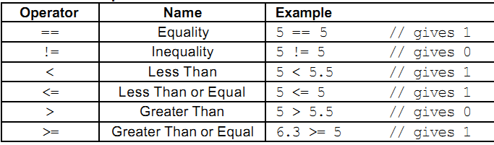
Note that these tests do not change the value of any variables, they are only compared.
The result of a test always has either the value of 0 or the value of 1 ( 0 for false and 1 for true).
C++ provides six relational operators for comparing numeric quantities.
These are summarized in the following table.

Slide 73
Note that the <= and >= operators are only supported in the form shown. In particular, =< and => are both invalid and do not mean anything.
The operands of a relational operator must evaluate to a number.
Characters are valid operands since they are represented by numeric values.
For example (assuming ASCII coding):
    'A' < 'F' // gives 1 (is like 65 < 70)
The relational operators should not be used for comparing strings, because this will result in the string addresses being compared, not the string contents.
For example, the expression, "HELLO" < "BYE“ causes the address of "HELLO" to be compared to the address of "BYE".
As these addresses are determined by the compiler (in a machine-dependent manner), the outcome may be 0 or may be 1, and is therefore undefined.

Slide 74
/*C++ program to demonstrate Relational or
Equality Operator */
#include <iostream>
using namespace std;
int main() {
int num;
//User Input the value of num
cout<<"Enter any integer number:";
cin>>num;
/*Compare or test the value inputed by the user
with the value 10 */
cout<<"num <10 is:"<<(num<10)<<endl;
cout<<"num >10 is:"<<(num>10)<<endl;
cout<<"num==10 is:"<<(num==10)<<endl;
cout<<"num>=20 is:"<<(num>=20)<<endl;
cout<<"num<=20 is:"<<(num<=20)<<endl;

Slide 75
cout<<"num!=20 is:"<<(num!=20)<<endl<<endl;
cout<<"******TO COMPUT CHAR VALUE*****"<<endl;
/*Characters are valid operands since they
are represented by numeric values */
//Compare char values
char a='A';
char b='F';
cout<<"A<F is:"<<(a<b)<<endl;
cout<<"A>F is:"<<(a>b)<<endl;
return 0;
}
Activity
Determine the output of the previous C++ program that demonstrates Relational or Equality Operator

Slide 76
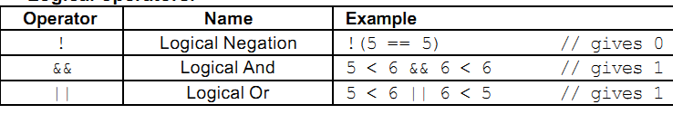
3. Logical Operators (Boolean Expressions)
The logical operators are called Boolean operators because the tests between values are reduced to either true or false, with zero being false and one being true.
Like the relational operators, logical operators evaluate to 1 or 0.
C++ provides three logical operators for combining logical expression. These are summarized in the following table.
Note that these operators do not change the value of the operands.
They only use the value of the operands to calculate a resulting value.

Slide 77
The value must be assigned with the assignment operator to affect the value of a variable.
Syntax: operand1 boolean_operator operand2
The logical AND operator evaluates the first operand, and if the result is true (a non-zero value), it evaluates the second.
If the second operand’s value also is true, the result of the operator is true (equals 1).
However, if the first operand evaluates false, the second operand is not evaluated and the result of the operator is false (equals zero).
Generally, Logical AND produces 0 if one or both of its operands evaluate to 0. Otherwise, it produces 1.

Slide 78
The logical OR operator evaluates both operands and if the result of both operand is zero. Then the result of the operator is zero; otherwise, the result is one.
Logical OR produces 0 if both of its operands evaluate to 0. Otherwise, it produces 1
Expression connected by && or || are evaluated left to right, and evaluation stops as soon as the truth or falsehood of the result is known.
Logical negation is a unary operator, which negates the logical value of its single operand.
If its operand is nonzero it produce 0, and if it is 0 it produces 1.

Slide 79
/* C++ Program to demonstrate Logical Operators
(LOGICAL AND, LOGICAL OR AND LOGICAL NEGATION */
#include<iostream>
using namespace std;
int main (){
//Declaration of variables and assign with some initial value
int x, y;
x = 2;
y = 3;
//Display the value of x and y
cout <<"x="<<x<<" "<<"y="<<y<<"\n";
//Implement LOGICAL AND Operator
if ((x==2) && (y==3))
cout<<"Both values matched as expected!"<<"\n";
if ((x==y) && (y>=3))
cout<<"Both condition were true"<<"\n";

Slide 80
else
cout<<"One of the condition were not true"<<"\n";
//Implement LOGICAL OR Operator
if ((x==5)||(y>=x))
cout<<"One of the expression is true"<<"\n";
else
cout<<"Neither expression or true, both false";
cout<<endl;
cout<<"*******LOGICAL NEGATION OPERATOR********"<<endl;
//Implement LOGICAL Negation Operator
cout<<"!(x==y):"<<!(x==y)<<endl;
cout<<"!(x<=y):"<<!(x<=y)<<endl;
cout<<"!(x>=y):"<<!(x>=y)<<endl;
return 0;
}

Slide 81
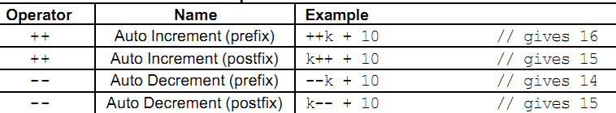
4. Increment/Decrement Operators
The auto increment (++) and auto decrement (--) operators provide a convenient way of, adding and subtracting 1 from a numeric variable respectively.
These are summarized in Table 2.7. The examples assume the following variable definition:
    int k = 5;

Slide 82
Both operators can be used in prefix and postfix form. The difference is significant.
i) When used in prefix form (++ and --)- (comes before operand) :
Operator is first applied and
The outcome is then used in the expression.
ii) When used in the postfix form (++ and --)- comes before operand :
The expression is evaluated first
And then the operator applied.
Both operators may be applied to integer as well as real variables, although in practice real variables are rarely useful in this form.

Slide 83
Activity
/*C++ program to demonstrate pre and post increment and
pre and post decrement on the variable m where m is
initialized at each time the operator performed and assign
the value to the variable n. The program output the value
of m and n respectively at each operation performed. */
#include<iostream>
using namespace std;
int main(){
// shows the difference between m++ and ++m:
int m, n;
m = 44;
//pre-increment operator is applied to m
n= ++m;
cout << "m="<<m<<",n="<<n<< endl;

Slide 84
//post-increment operator is applied to m
m = 44;
n= m++;
cout << "m="<<m<<",n="<<n<< endl;
// shows the difference between m-- and --m:
//pre-decrement operator is applied to m
m=44;
n=--m;
cout << "m="<<m<<",n="<<n<< endl;
//Post-decrement operator is applied to m
m=44;
n=m--;
cout << "m="<<m<<",n="<<n<< endl;
return 0;
}

Slide 85
5. Assignment Operator
The assignment operator is used for storing a value at some memory location (typically denoted by a variable).
The assignment operator is to “set equal to.”
The variable on the left side of the equal sign is set equal to the value of the operand on the right side of the equal sign.
The operand on the right side may be an expression that contains other operands and operators.
The special character used for the assignment operator is the equal sign.
Syntax: operand1=operand2;
The assignment operator specifies that the first operand is assigned the value of the second operand.
Operand2 is evaluated and the result is assigned to operand1.
x=y; /* is set equal to the value of y */
It is also use other special character with equal sign in assignment operator. The following table illustrate this.

Slide 86
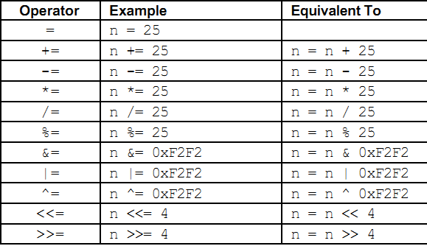
An assignment operation is itself an expression whose value is the value stored in its left operand.
An assignment operation can therefore be used as the right operand of another assignment operation.
Let’s see the following different examples to illustrate the assignment operator.

Slide 87
Activity
/*C++ Program to illustrates Assignment operator and
the assignment Operator is used together with some
Arithemetic operators*/
#include <iostream>
using namespace std;
//Main function
int main() {
//Declaration of Variables
int n=10;
cout<<"n="<<n<<endl;
//Use Assignment operator with other Arithmetic operators
n+=10;//is equivalend with n=n+10
cout<<"n="<<n<<endl;

Slide 88
n-=10;//is equivalend with n=n-10
cout<<"n="<<n<<endl;
n*=10;//is equivalend with n=n*10
cout<<"n="<<n<<endl;
n/=10;//is equivalend with n=n/10
cout<<"n="<<n<<endl;
n%=10;//is equivalend with n=n%10
cout<<"n="<<n<<endl;
return 0;
}
What is the output of the above C++ Program

Slide 89
6. Conditional Operator
The conditional expression operator is a condensed form of an if-then else statement.
The question mark and the colon are the special characters used to form the conditional expression operator.
format: operand1 ? operand2: operand3
The conditional expression specifies that the operand1 is evaluated and, if the result is true (non-zero value) then operand2 is evaluated.
The result, then of the conditional expression is the value of operand1.
If, however, the result of operand1 is false, then operand3 is evaluated and its result is the value returned by the conditional expression.

Slide 90
Example
// C++ Program to demonstrate Conditional Operator
#include<iostream>
using namespace std;
int main() {
int passing, failing, grade_average;
passing =0; failing=0;
grade_average =75;
(grade_average >=70) ? passing++ : failing++ ; //line 1
cout<<"Number Passing ="<<passing <<"\n";
cout<<"Number Failing ="<<failing;
return 0;
}
In line 1, the conditional statement is evaluated of which result is true. Therefore, the first operand is evaluated and not the second.
The result of the first operand evaluation increments the variable passing from 0 to 1; therefore the result of this expression is 1.

Slide 91
7. Comma Operator
Multiple expressions can be combined into one expression using the comma operator.
The comma operator takes two operands.
It first evaluates the left operand and then the right operand, and returns the value of the latter as the final outcome.
For example:
    int m, n, min;
    int mCount = 0, nCount = 0;
    //...
    min = (m < n ? mCount++, m : nCount++, n);
Here when m is less than n, mCount++ is evaluated and the value of m is stored in min.
Otherwise, nCount++ is evaluated and the value of n is stored in min.

Slide 92
2.1.3 Activity
A certain company plan to give 65% of bonus of the salary to each of its employees at the end of every year for those who are working more than two years in the company. The bonus does not deduct the tax pay to the government and Net payment to employee is including basic salary and bonus.
Analyze the Problem
Write the Pseudocode Program to design the algorithm for this problem.
Write C++ program to calculate (compute) a bonus and Net Payment of an employee. Suppose the program accept service year of employee and basic salary as an input.

